Slide 1
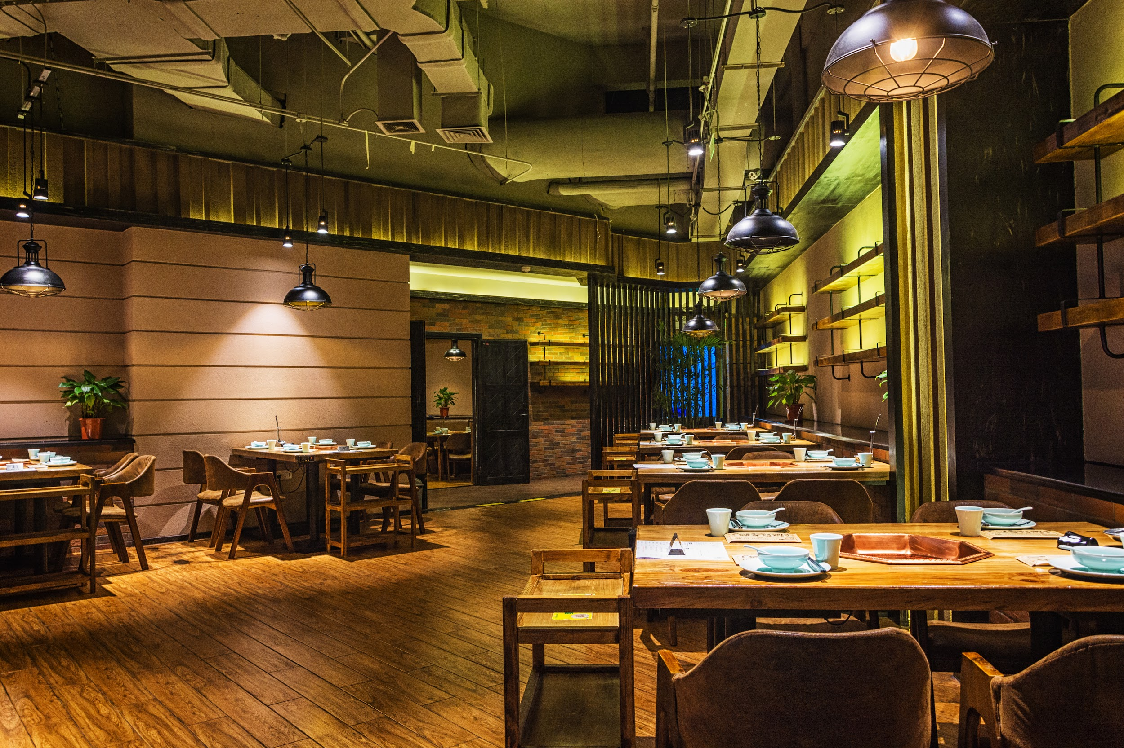
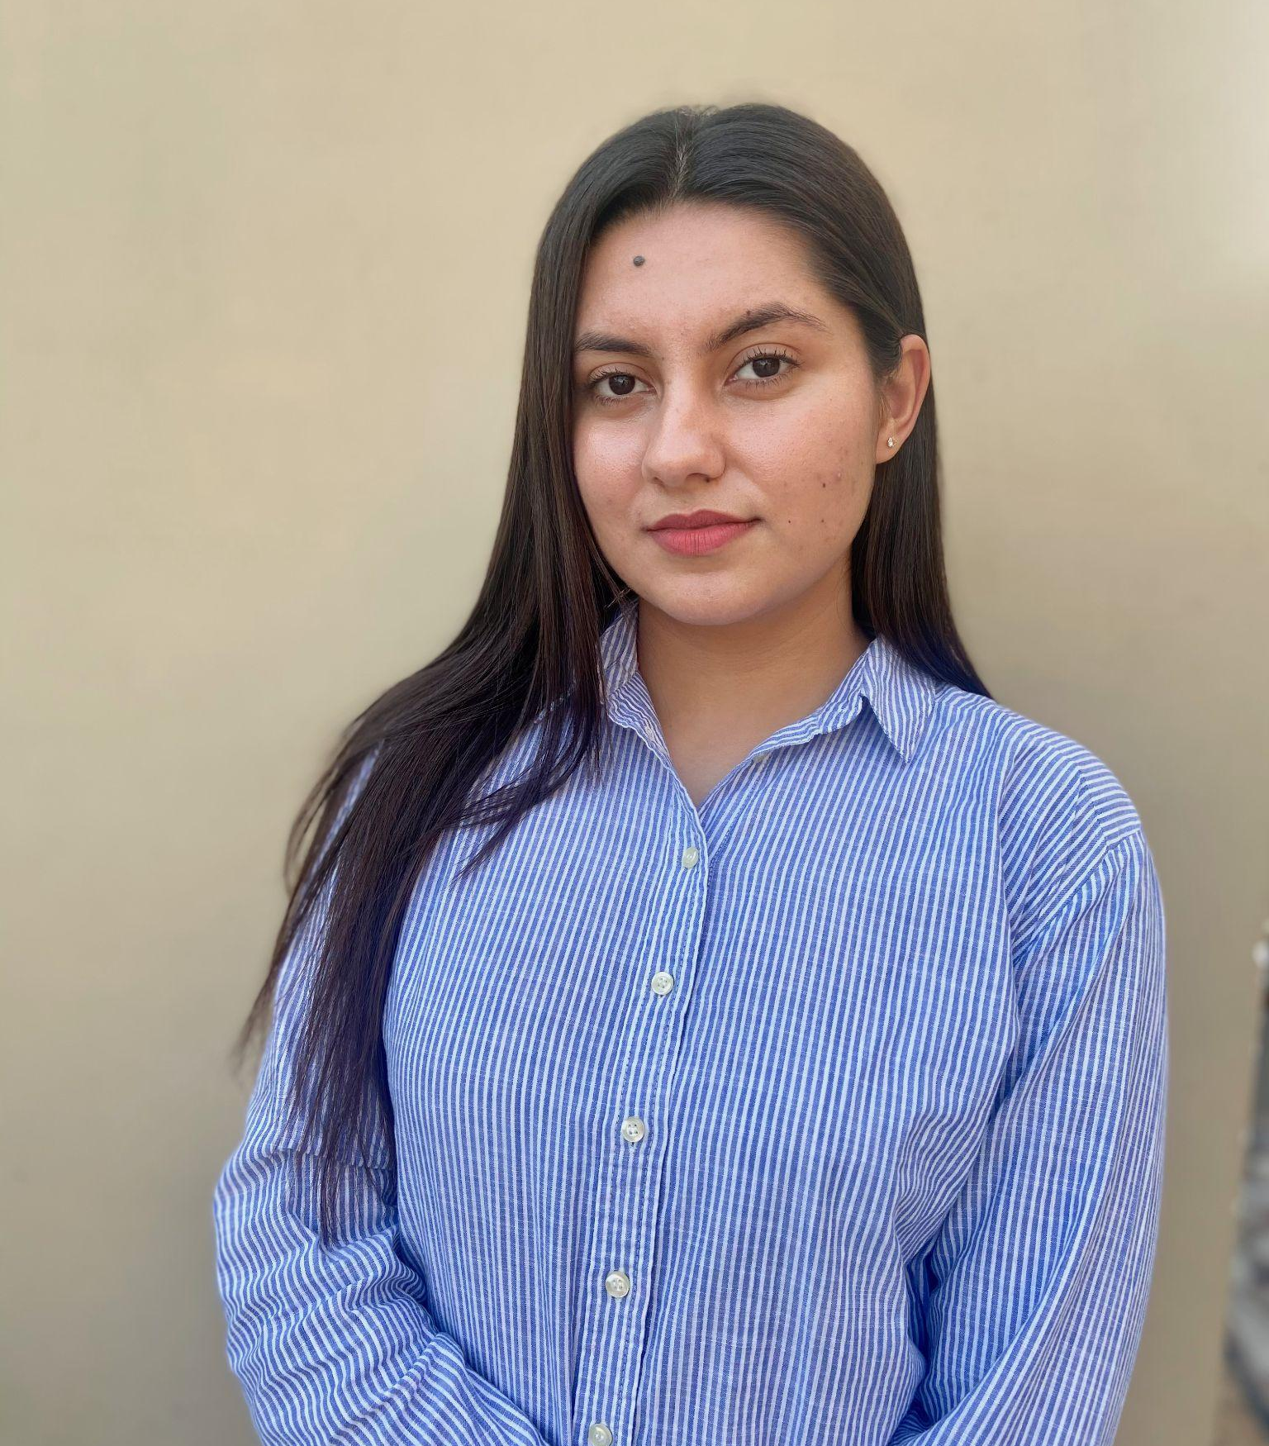
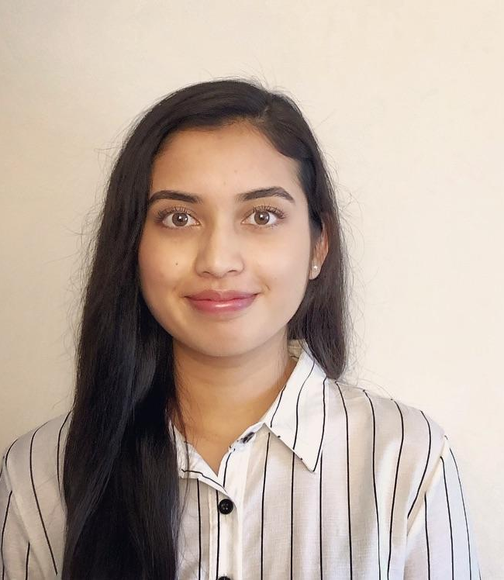

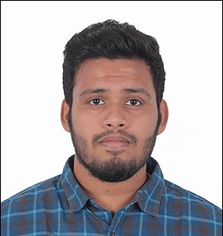
Restaurant Management Database
Manmeet Kaur
Babina Basnet
Shubham Patil
Rahul Yatagiri

Slide 2

Agenda
Introduction
Background of our project
ERD
Reports
Challenges and Reflections
Conclusion
Notes:
Now that we have gone over the introduction, I will briefly go over the layout of our presentation.
We will start with the background of our project, going over the purpose of the project and the questions we wanted to answer
Manmeet will go over our ERD
Shubham will go over the reports that we conducted. He will showcase the outputs of our queries on DBeaver.
Rahul will go over some of the challenges that we faced and also provide some recommendations for what we could have done better if we were to re-do this project over again.
And with that we will conclude our presentation

Slide 3
Background of the report
Purpose
To address the operational complexities of modern restaurants by creating a centralized system for:
Employee management.
Inventory control.
Order processing and payment tracking.
Customer relationship management.
Key Questions to Answer:
How can we optimize inventory management to prevent shortages or overstocking?
Who are the top spenders and how do they compare to regular spenders?
Which payment methods are most used, and how can promotions target those preferences?
Which customers contribute the most to total sales at each restaurant?
How can we better engage high spenders to increase their loyalty?
Notes:
The purpose of our project is to address the current complexities in restaurant management by creating a centralized and more stream-lined system for employee management, inventory control, order processing and payment tracking, which would all help us with customer relationship management.
SOme of the questions we wanted to answer using our project were the following:
WHich customers contribute the most total sales at each restaurant?
Who are the top spenders and how do they compare to the regular spenders?
How can we optimize inventory management to prevent shortages or overstocking?
What payment methods are most used and how can we incentivize those preferences?
How can we better engage high spenders to increase their loyalty?

Slide 4
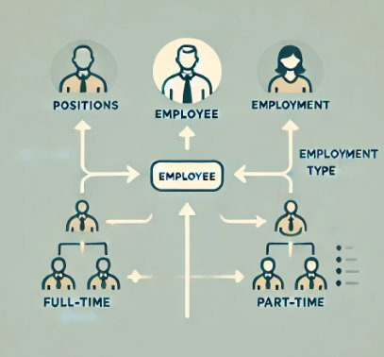
Employees: Integral To Delivering Quality Restaurant Experience

Slide 5
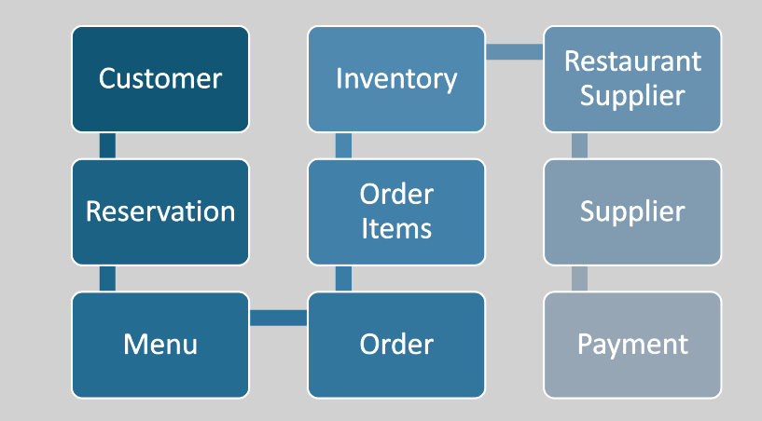






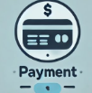

The Start-To-End Restaurant Operation

Slide 6
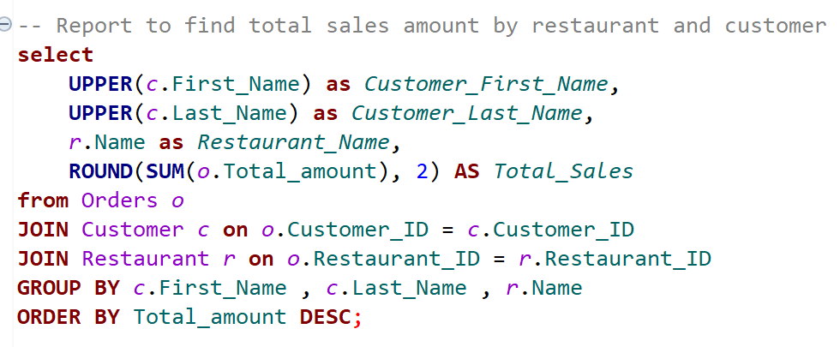
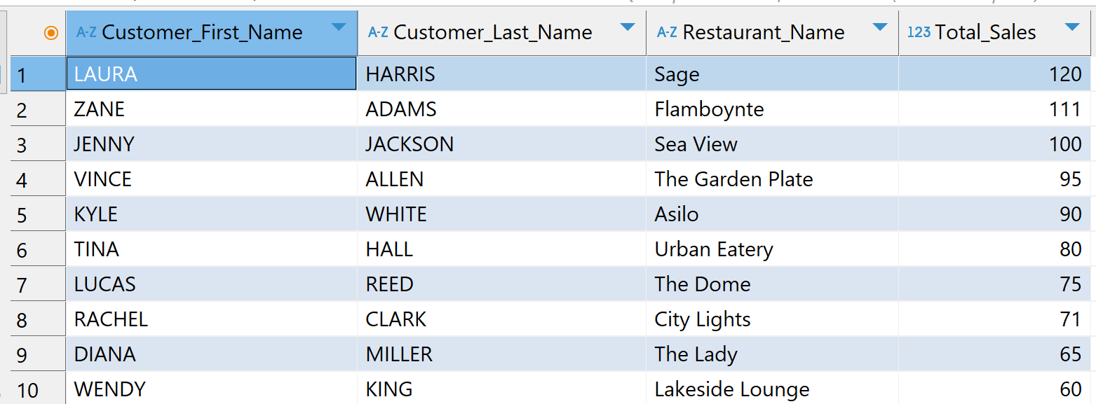
Report 1
To find total sales amount by restaurant and customers-
Business Value-
Revenue Tracking
Cash flow management
Pricing Strategies
Notes:
Here we will try to emphasize on Business values and what business decisions can be made using the outputs to optimize the revenue for the restaurants.

Slide 7
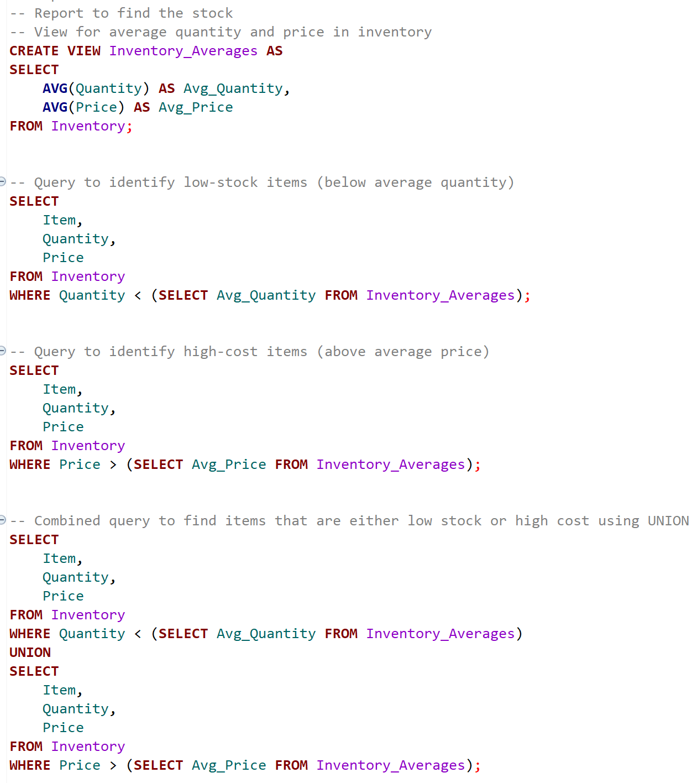
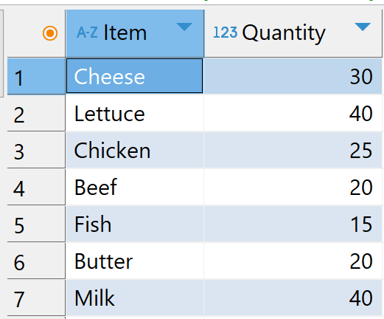
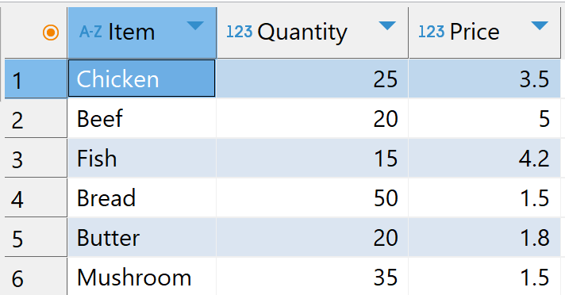
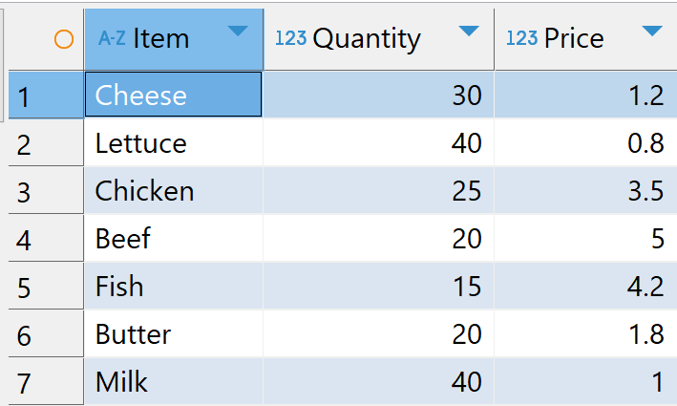
Report 2
To find low stock and high price items- Low Stock Items- High Price Items-
Low stock & High price items using Union operator-

Slide 8
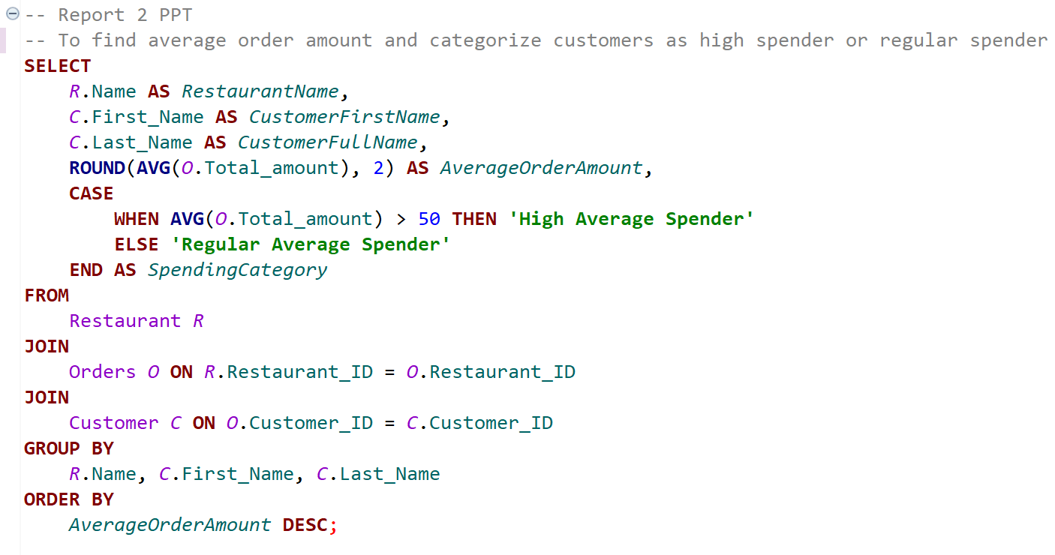
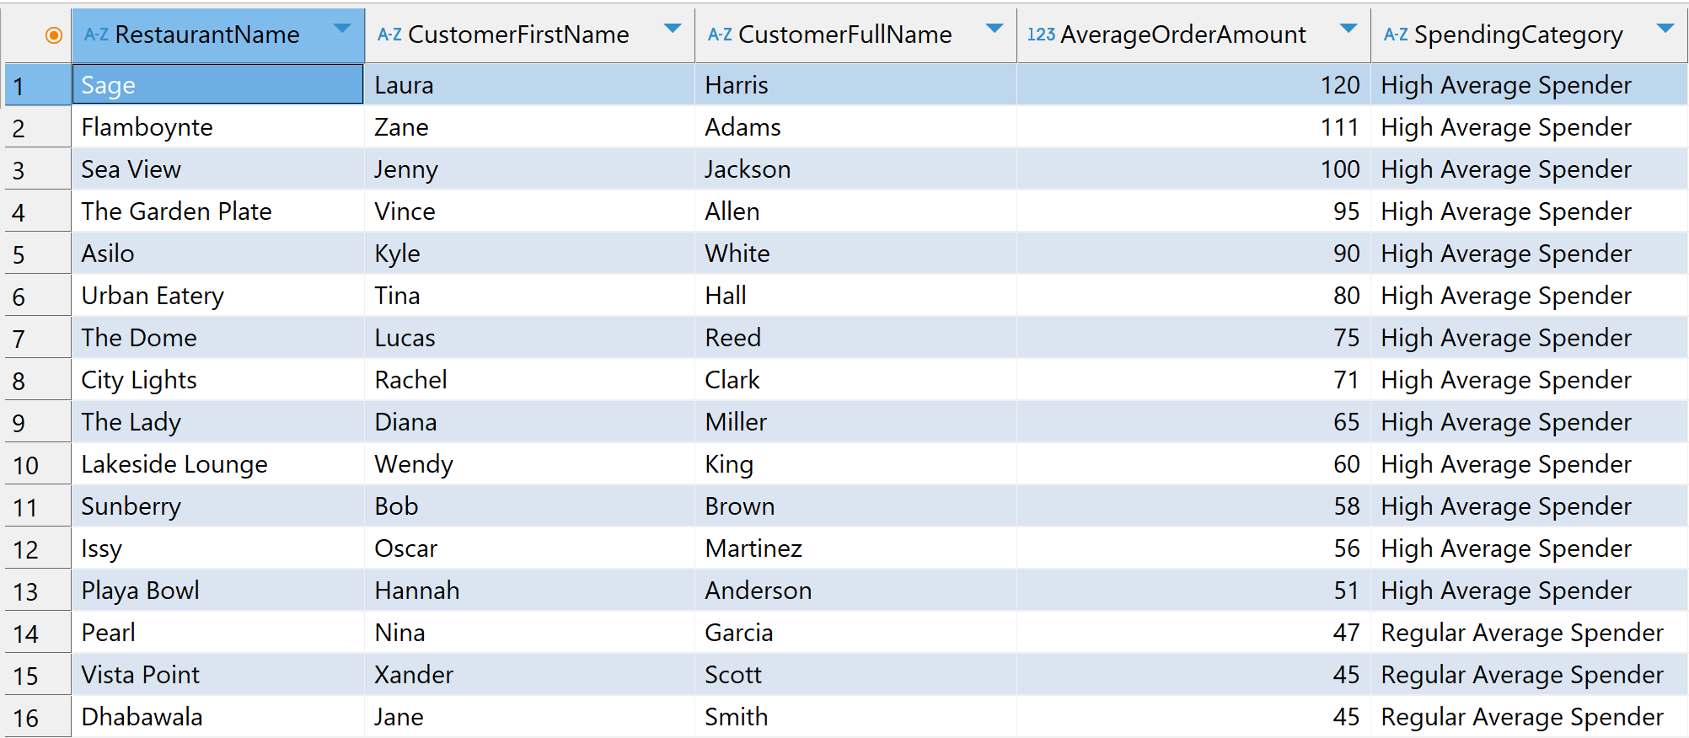
Report 3
To categorize customers as high spender or regular spender-
Business Value-
Customer Segmentation
Run promotional discounts

Slide 9
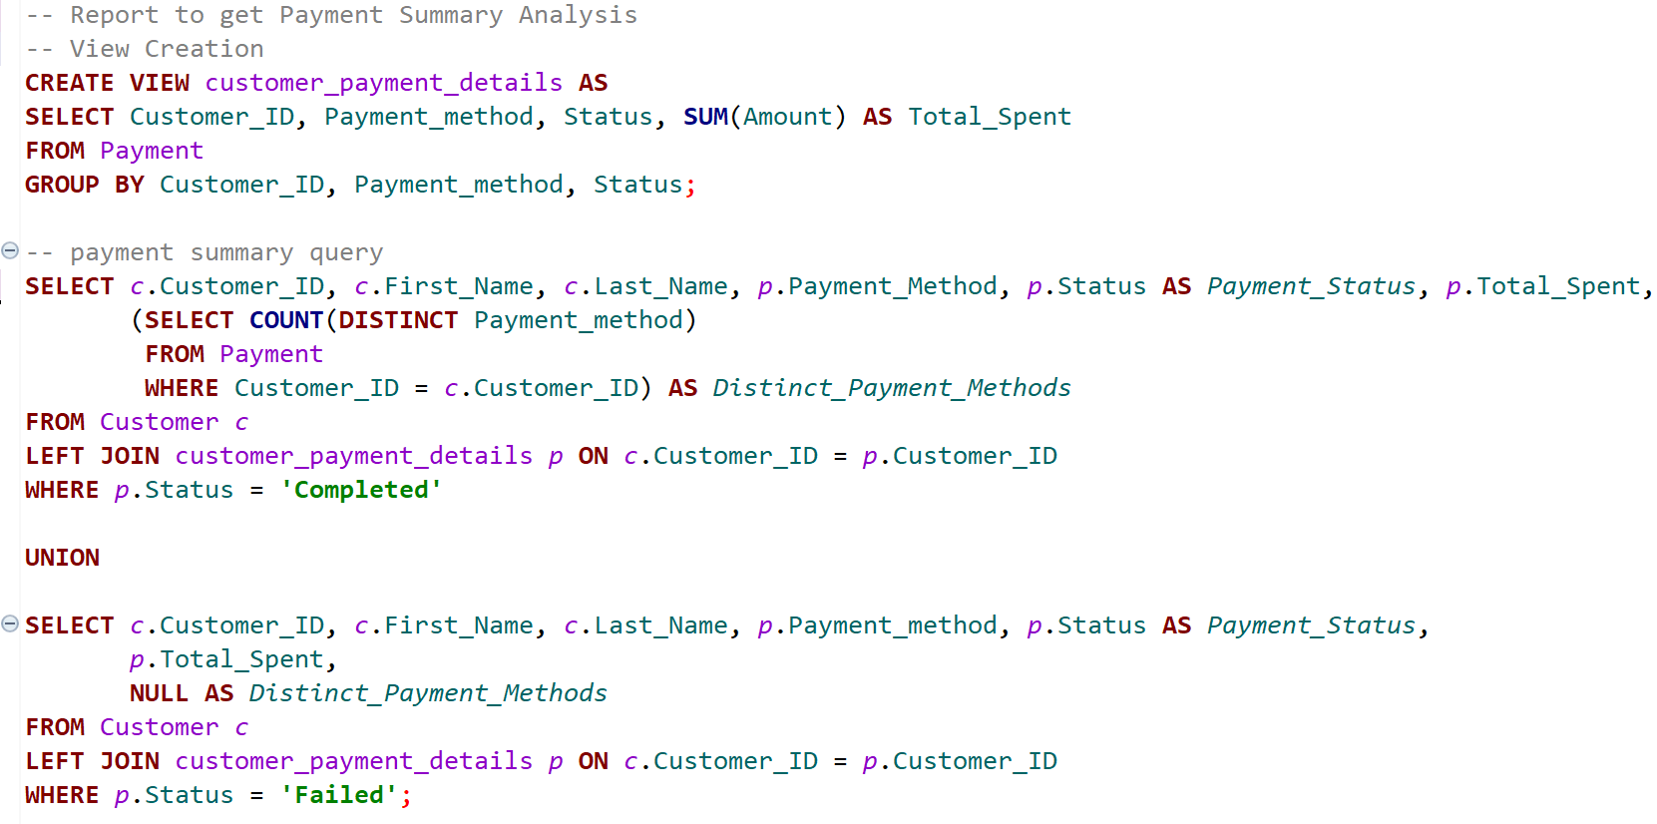
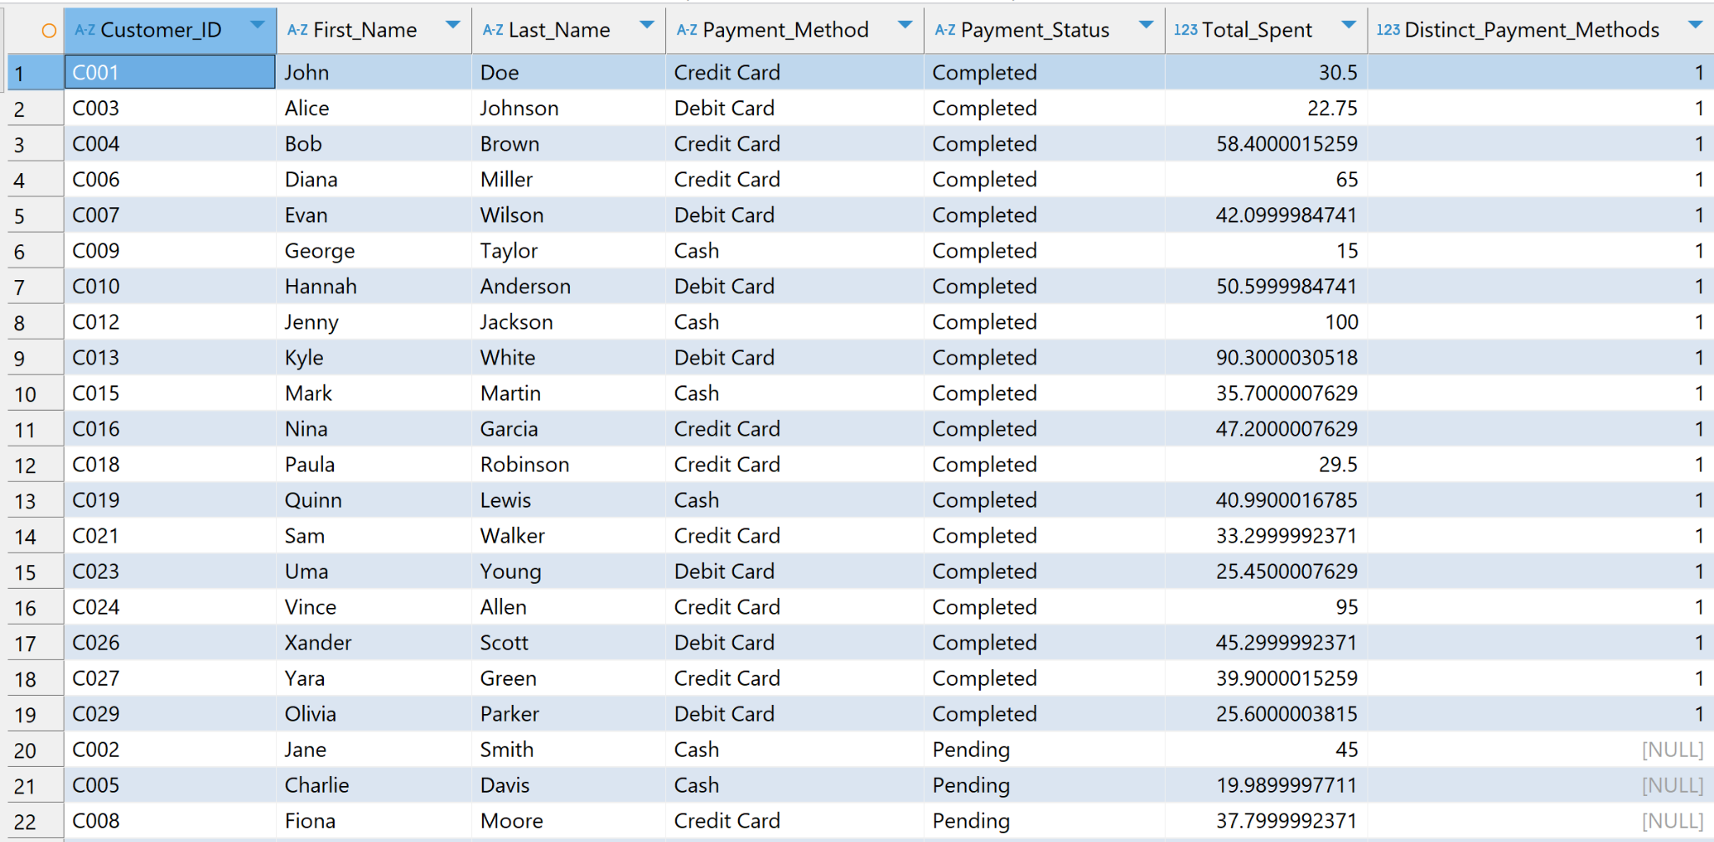
Report 4
Report to get payment summary-
Business Value-
Improved customer experience
Targeted promotions
Reduce operational costs

Slide 10
Challenges & Reflections
To address limited data diversity during database population, we streamlined our SQL queries to work effectively with limited dataset while ensuring scalability for future iterations. This approach allowed us to maintain progress and deliver meaningful insights while planning for enhanced data diversity in future updates.
We suggest adding more entities, such as customer ratings, to enhance data richness and provide deeper insights into customer satisfaction and preferences.

Slide 11
Conclusion
The Restaurant Management System effectively demonstrated the design and implementation of a comprehensive database to streamline operations. It provided valuable insights into customer behavior, inventory management, and financial tracking, enabling data-driven decision-making.
Our project showcases the potential of SQL-driven systems to enhance operational efficiency and optimize business processes, laying a strong foundation for scalable and insightful restaurant management solutions.

Slide 12
Thank you
^{Q&A}

